Slide 1
Jan Amos Komenský University Prague and the Czech HE System
Petr Kolář
Vice-Rector
for Development, Research, and International Relations
September 21, 2020

Slide 2
Position of UJAK within the HE System
Private HEI, established 2001
First Czech private university (since 2006)
Individual Associate Member of the
European University Association (2007-2019)
Member of the
Czech Rectors‘ Conference – CRC (since 2002)
UJAK‘s Rector was a Vice-President of CRC
Membership in the
Presidium of the HEIs Council of CR
Erasmus Charter for Higher Education (since 2005)
Research Organization (since 2010)

Slide 3
Position of UJAK within the HE System
Full university status, fully ACCREDITED
Bachelor, Master‘s, and PhD. Studies
Research (national, international)
International MBA Programme (2008-2020)
Full Bologna structure of study
European recognition of diplomas
Study for foreign students
Prague Centre Campus
Unique orientation to education, teachers training, and human resources development in wider context
Massive re-accreditation process due to new national legislation (since 2017)

Slide 4
UJAK in Figures 2019/2020
Students enrolled 1627
Academic Staff 69
Experts from practice 22
Administration 23
Graduates 714
Student dropout 9,59 %

Slide 5
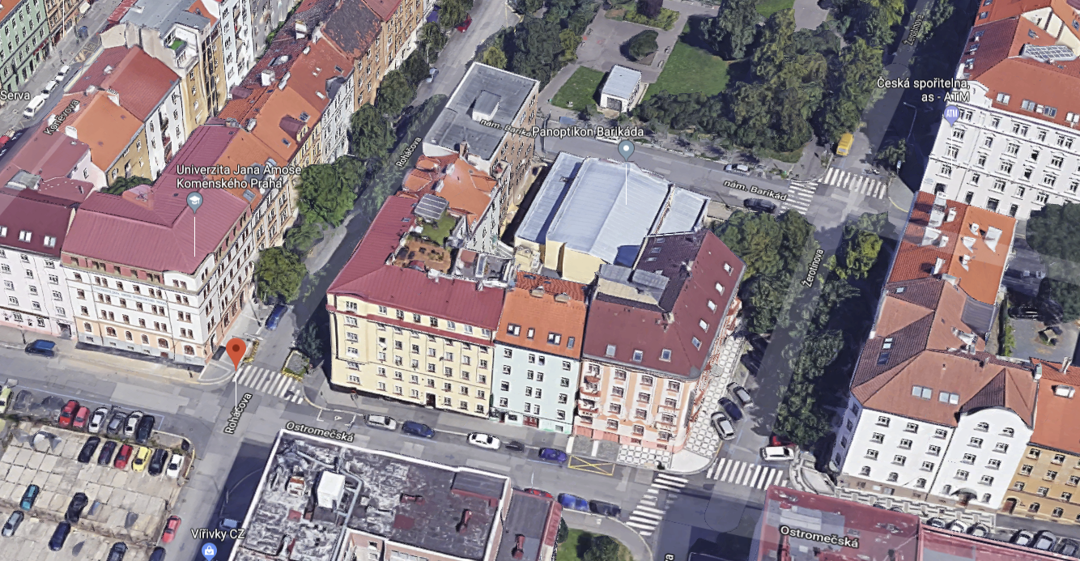
Univerzita Jana Amose Komenského Praha – komplex budov
Parkoviště UJAK
Budovy A, B
Roháčova 63
Budova C
Ostromečská 8

Slide 6
Study at UJAK

Slide 7
Study at UJAK
General:
Humanities and Social Sciences
On-site and combined study in all programmes
New structure since 2020
Bachelor`s
6 „old“ study fields (accred. until 2024)
5 new study programmes
1 new programme under accreditation
Master`s
1 „old“ study field (accred. until 2024)
1 new programme under accreditation

Slide 8
Study at UJAK
Doctoral
1 „old“ study field (accred. until 2024)
MBA
International accreditation by FIBAA (2008-2020)
Preparation of programme for national accreditation (CAMBAS) in 2020
Life-long learning courses
Teachers training (various)
Foreign languages (telc Euro-certificates)

Slide 9
Study at UJAK
Study Programmes:
Bachelor‘s (3-year)
Andragogy
Special Education
International Relations and Diplomacy
Resocialization and Penitentiary Education
European Economic and
Public Administration Studies
Law in Enterpreneurship
Audio-visual Communication and Creation
Scenic and Media Studies

Slide 10
Study at UJAK
Master‘s (2-year follow-up)
Andragogy
Doctoral (3-year, individual study plan)
Andragogy
Under accreditation
Communication Studies (Bc.)
Andragogy (Mgr., new accreditation)

Slide 11
Study at UJAK
Master of Business Administration (MBA)
Internationally accredited by FIBAA Bonn untill 2020
Continuous accreditation since 2008.
Uniquely focused upon HR management and the European Union
3-semester study

Slide 12
Research at UJAK
Co-operation in Research, Development, and Innovation projects – areas of interest:
National Tertiary Education Reform
National Research Support System
Human resources development
Methodologies of Education
New Educational Forms and Methods:
distance education, e-learning
Communication and Media
Special Education
Adult Education / Andragogy
Economy, Political science, Global studies
Law
Development – European Social Fund projects

Slide 13
International Co-operation at UJAK
Student and staff mobility
Erasmus Charter for Higher Education
Erasmus+ (2014-2020, 2021+)
International co-operation (50 agreements)
Austria, Belgium, Bulgaria, Croatia, Denmark, Finland, France, Germany, Hungary, Italy, Latvia, Lithuania, Malta, Norway, Poland, Portugal, Romania, Russia, Slovakia, Spain, Sweden, Turkey, Vietnam, China, Kazakhstan

Slide 14
Other Academic Activities at UJAK
Jan Amos Komenský University
Publishing House
Jan Amos Komenský University
Audio-Visual Studios (TV, radio)
Jan Amos Komenský University
Andragogy Review
University Letters

Slide 15
Publishing House and Library

Slide 16
AV Studio UJAK

Slide 17
AV Studio UJAK

Slide 18
Thank you for your attention
More information:
www.ujak.cz
Brochures & leaflets

